Slide 1
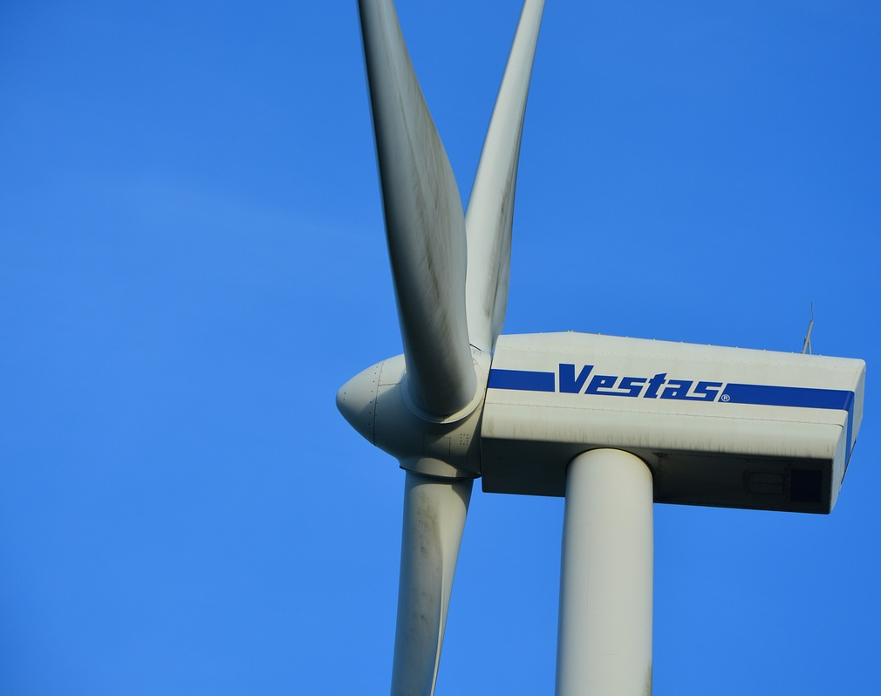
Maritime Wind Speed Prediction Using Buoy LIDAR Data
Team: Brian Waite, Carl Walenciak
Southern Methodist University
Time Series Analysis
Prof. B. Sadler

Slide 2
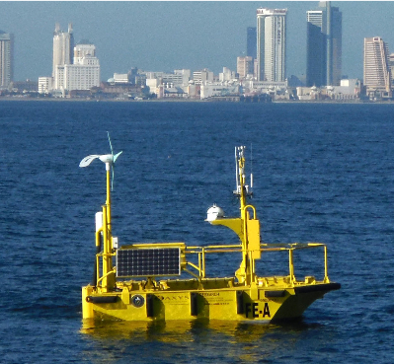
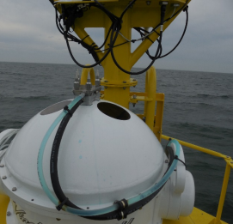
What is Buoy LIDAR Data?
Pacific Northwest National Labs (PNNL) in support of U.S. Department of Energy (DOE)
Buoy collects comprehensive meteorological and oceanographic data characterize offshore wind energy.
LIDAR – LIght Detection And Ranging
Using Data from April 2016 buoy deployment. (Specifically 01-20 April)
https://wind.pnnl.gov/lidarbuoyloanprogram.asp
https://wind.pnnl.gov/pdf/Example_Monthly_Report.pdf

Slide 3
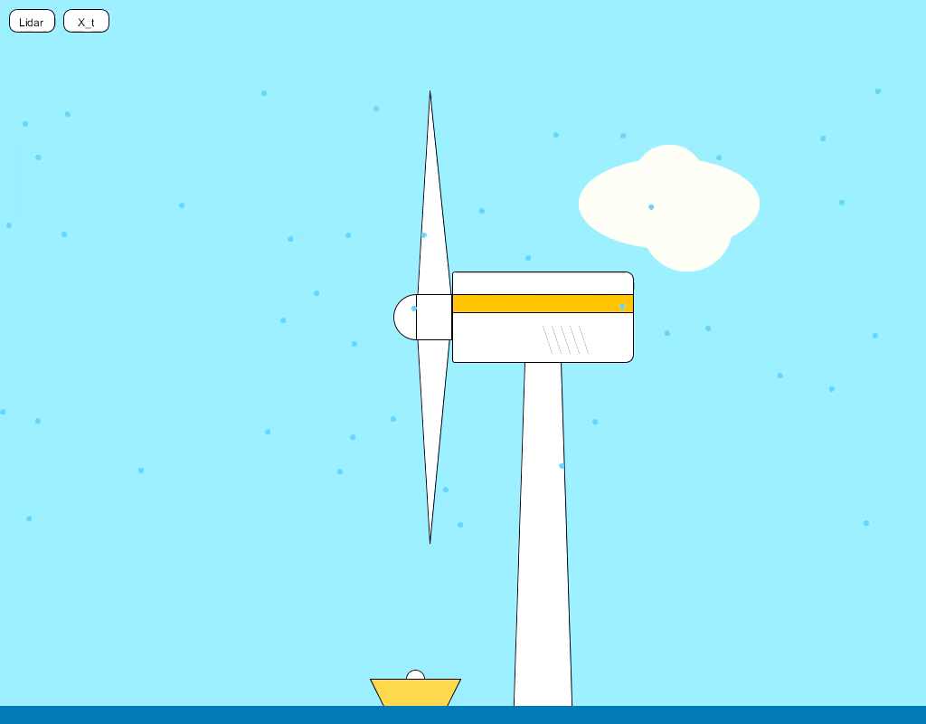

Slide 4
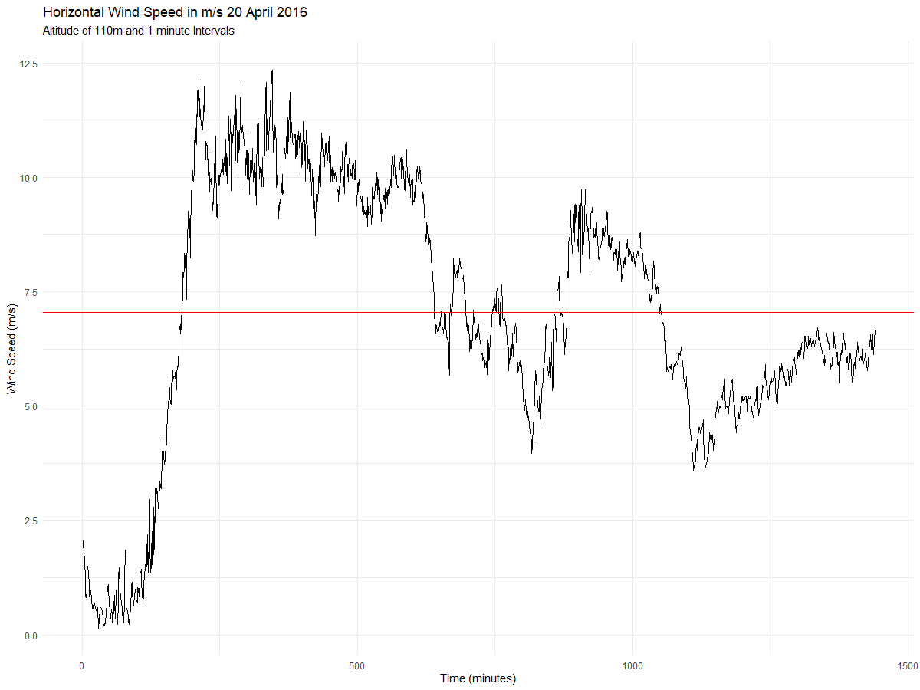
Realization
X_{bar}
But what does it mean?

Slide 5
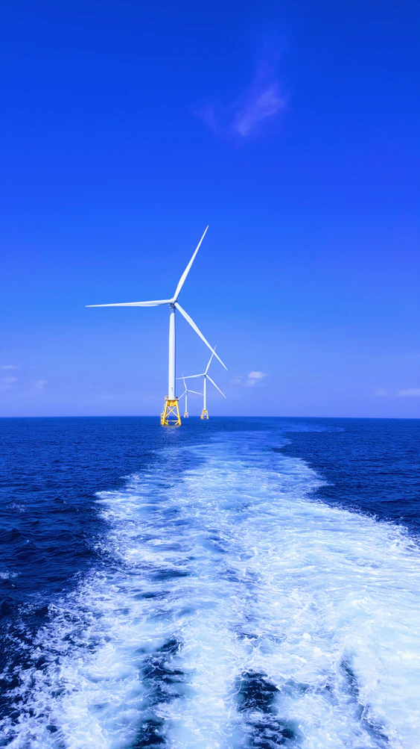
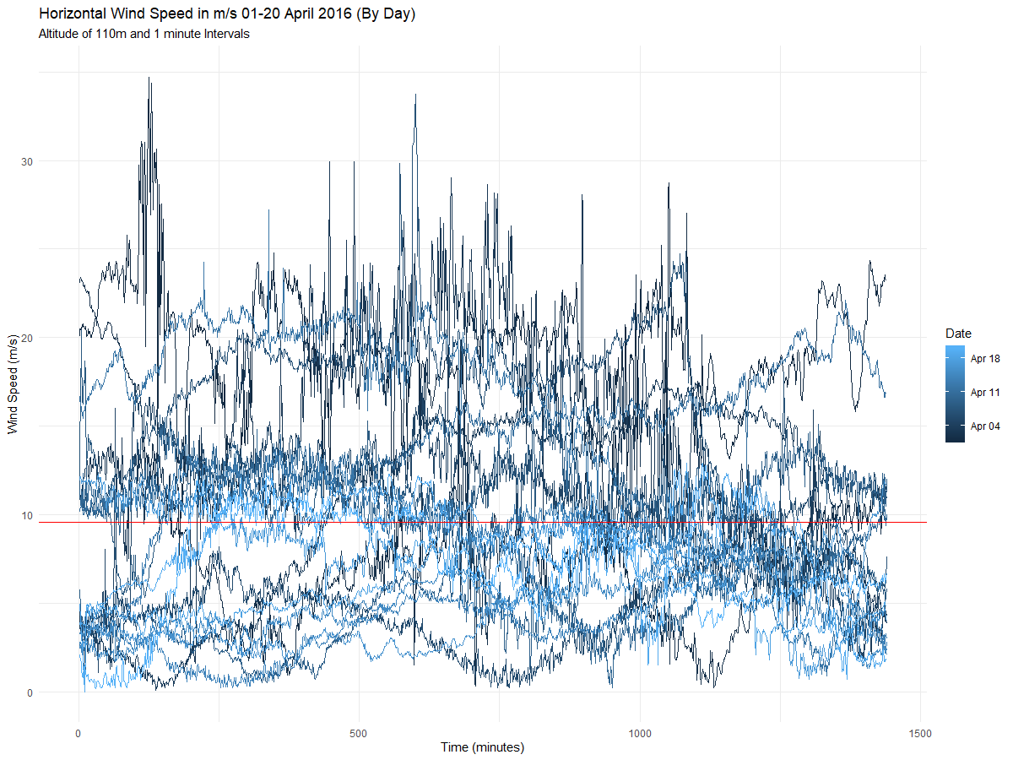
Note about distribution:
Our research indicates wind follows a Weibull distribution (right skewed), but we assume normality to be able to continue with research.

Slide 6

Stationarity Evaluation
Condition 1: Mean does not depend on time
Condition 2: Variance does not depend on time
Condition 3: Autocorrelations constant regardless of where we look in the series

Slide 7
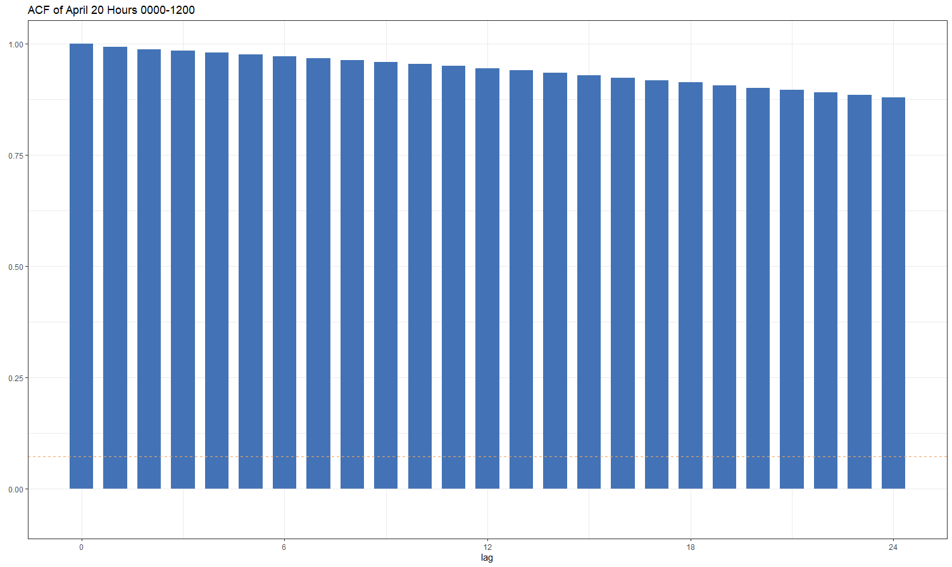
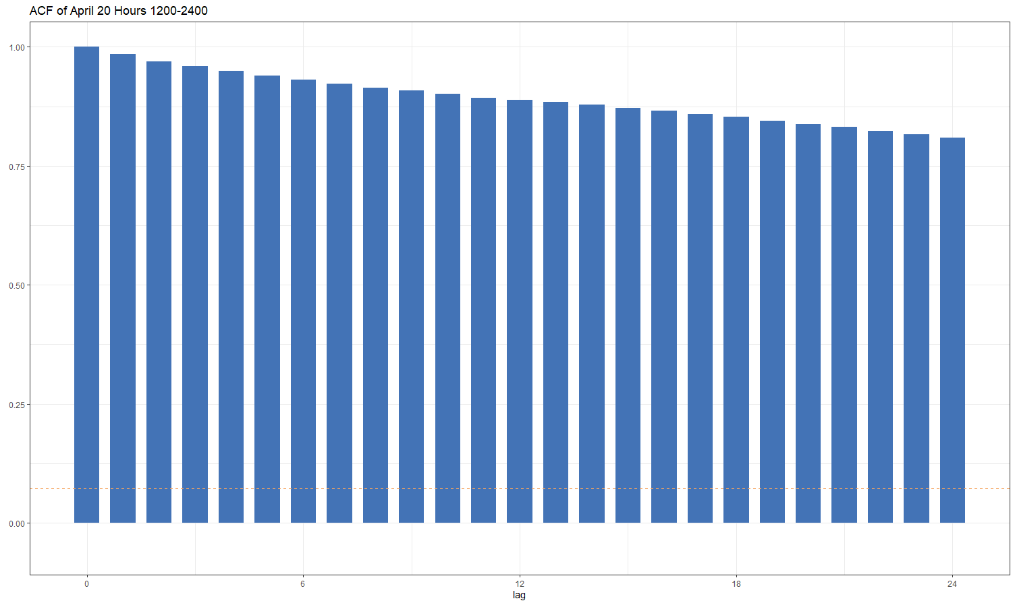
Stationarity Evaluation
Condition 1: Mean does not depend on time
Condition 2: Variance does not depend on time
Condition 3: Autocorrelations constant regardless of where we look in the series
Note the slight oscillation, particularly in the second half

Slide 8
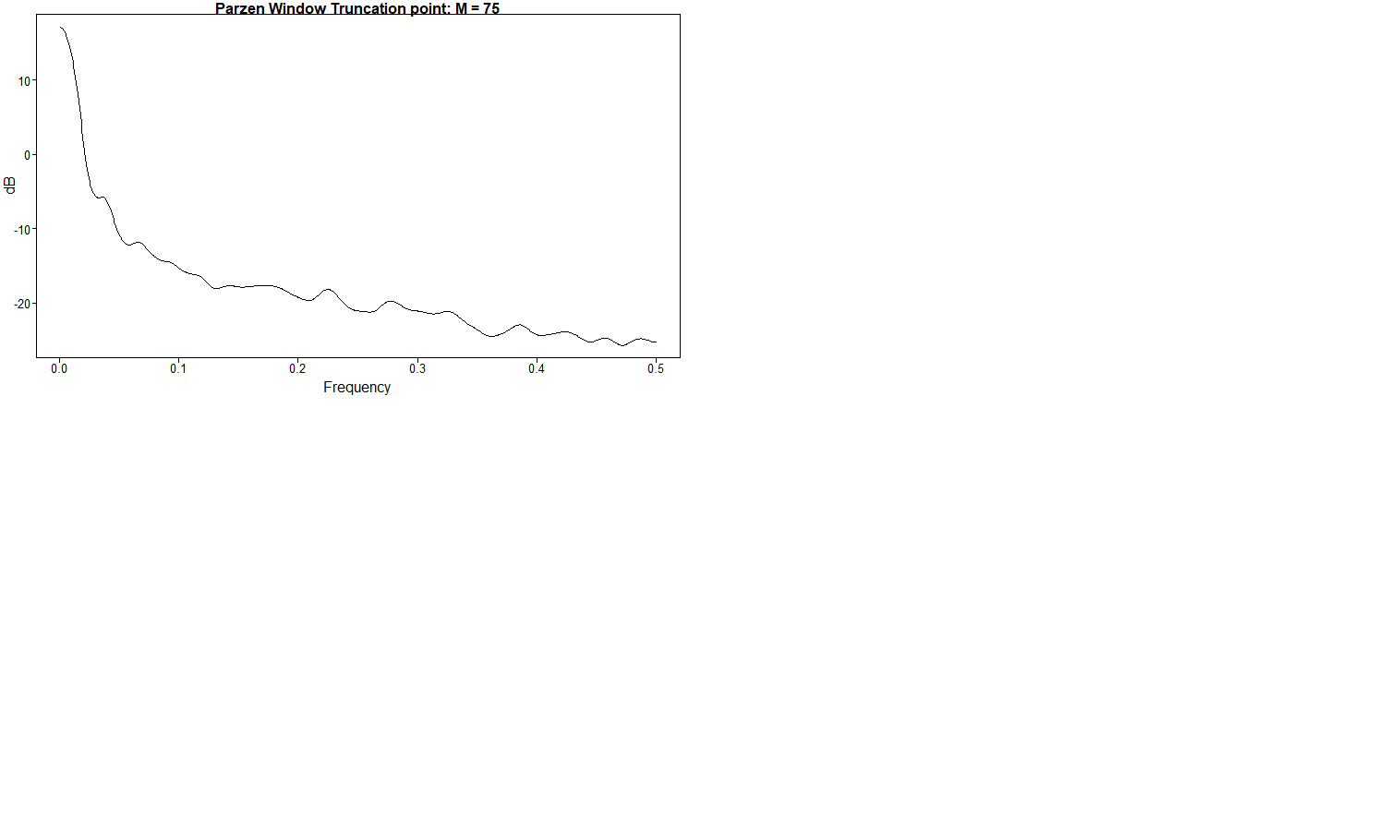
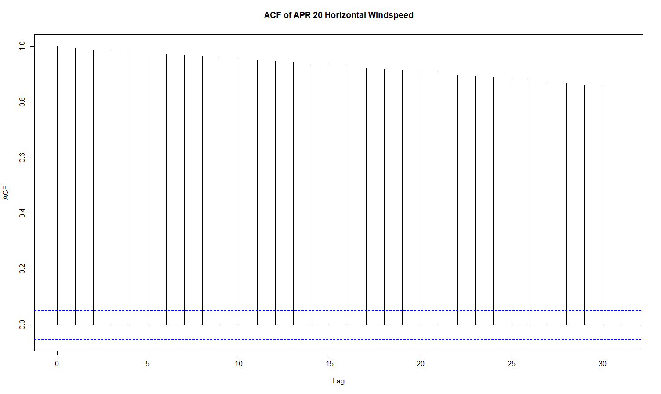
Spectral Density and Autocorrelation

